Slide 1
Deduplicating Cloud Functions - Demo 1
Mentor: Shripad Nadgowda (nadgowda@us.ibm.com)
Beliz Kaleli
bkaleli@bu.edu
Vikash Sahu
vksahu@bu.edu
Paritosh Shirodkar
paritosh@bu.edu
Asutosh Patra
asupat12@bu.edu
Notes:
‹#›

Slide 2
Project Overview
Aim:
Develop function de-duplication framework for serverless platform
Our Clients:
Cloud users who use serverless computing
Cloud vendors

Slide 3
What is Serverless?
A way to build and run applications and services without having to manage infrastructure
Application still runs on servers
Cloud Provider does: server management for applications and databases, provisioning, scaling

Slide 4



Serverless Functions
Stateless and idempotent
Types of functions:
1. Storage Closed Loop 2. External Stimuli
f()
f()
External Event
Data
Store
Data
Store

Slide 5
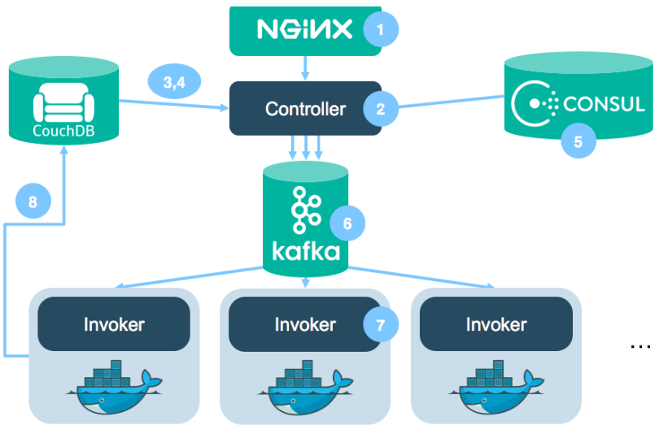
How does Serverless Work?
Steps:
SSL Terminator forwards HTTP Req.(user command)
Check if user exists in OpenWhisk and their privileges
Consul finds available invokers
Controller chooses one invoker
Controller publishes message to Kafka(action+parameters)
ActivationId is sent to user
A Docker container spawned, code injected, executed, result obtained, container destroyed
Result is stored in DB
Fig 1. OpenWhisk architecture, Retrieved from:
https://medium.com/openwhisk/uncovering-the-magic-how-serverless-platforms-really-work-3cb127b05f71

Slide 6
Demo

Slide 7
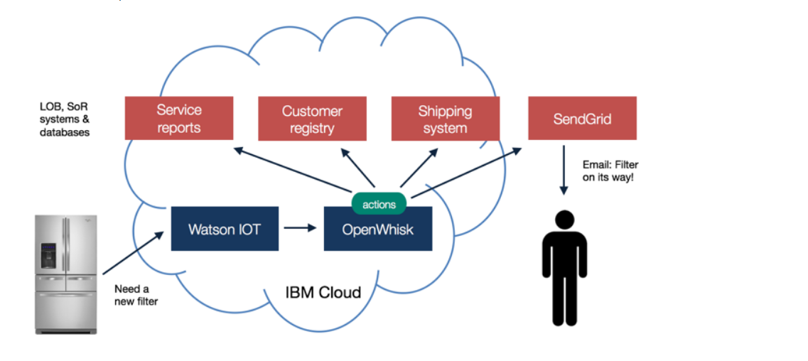
Real world Use Case
Trigger:Collect sensor data on a daily basis
Actions:Run service diagnosis event daily
Rules: If an anomaly occurs, run an event which determines the need of a new filter event
Fig 2. IoT Openfridge Use-case Example, Retrieved from:
https://github.com/IBM/ibm-cloud-functions-serverless-iot-openfridge

Slide 8
Motivation
Most cloud platforms today follow the ‘pay only for what you use’ model i.e. you are charged based on the number of requests for your functions and the duration, the time it takes for your code to execute.
But what if we could reduce the number of requests for functions?

Slide 9
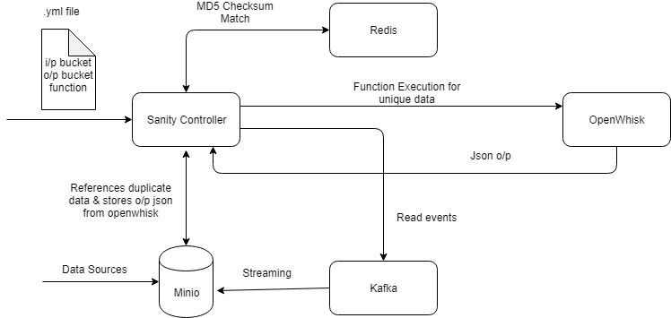
Proposed Architecture

Slide 10
Exploration of Sanity Controller
The survey for Sanity system was evaluated with its performance and resource overhead for one real-world use case of continuous container vulnerability analysis.
During this research, with modest overhead of 2GB memory it can help improve the latency of function for duplicate data by about 200x.
Reference: http://niltonbila.com/pub/Nadgowda-WoSC17.pdf

Slide 11
Scope
Current Challenges
Our intention is not to deduplicate data but to deduplicate invocation of cloud functions
We are going to make a POC on top of Openwhisk platform
To containerize each application and run serverless computation to identify duplicate functions
Integrate each components in Sanity architecture.

Slide 12
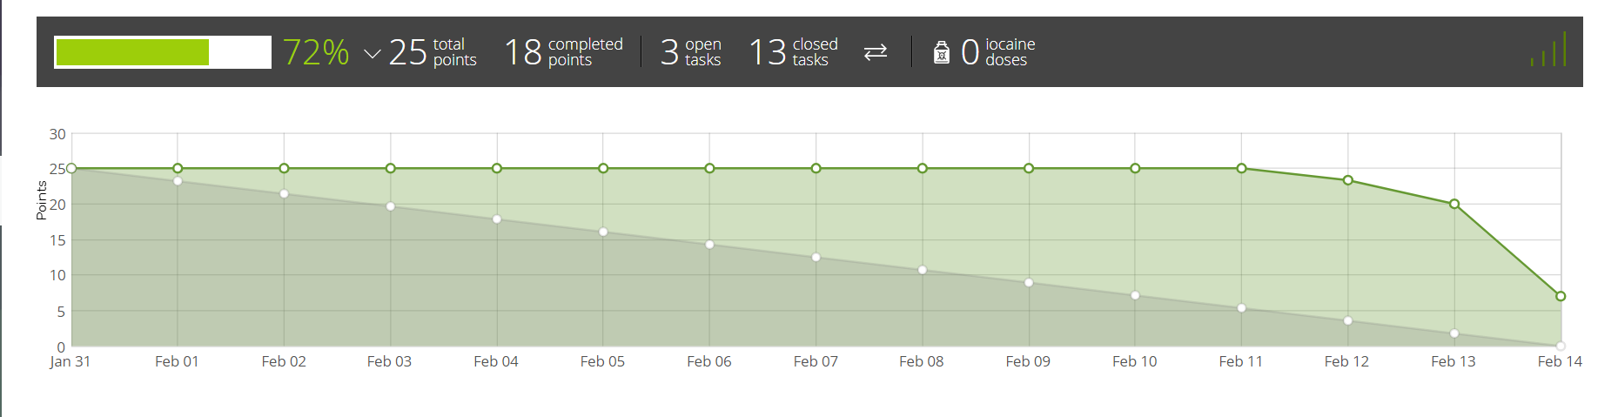
Burndown Chart

Slide 13
Next Sprint
Integrate a Proof of Concept (POC) for the Sanity system for deduplication of cloud functions
Initiate a full trigger of Openwhisk with reference to serverless architecture
Better estimation of our tasks and a better burndown pace

Slide 14
References
[1](n.d.). Retrieved from https://tree.taiga.io/project/bowenislandsong-deduplicating-cloud-functions/taskboard/sprint-1-13886Ibm. (2018, December 12).
[2]IBM/ibm-cloud-functions-serverless-iot-openfridge. Retrieved from https://github.com/IBM/ibm-cloud-functions-serverless-iot-openfridge
[3]Sanity: The Less Server Architecture for Cloud functions. (n.d.). Retrieved from https://www.serverlesscomputing.org/wosc2/presentations/p4-Sanity-WoSC_v0.pdf
[4]Thömmes, M., & Thömmes, M. (2016, October 11). Uncovering the magic: How serverless platforms really work! Retrieved from https://medium.com/openwhisk/uncovering-the-magic-how-serverless-platforms-really-work-3cb127b05f71

Slide 15
Thank You

